Slide 1


Heart Disease Diagnosis Chatbot using DifY AI
This presentation explores the development and application of an AI-powered chatbot built using Dify AI and the Kaggle Heart CSV Dataset. The chatbot provides personalized health advice and insights based on user-provided information.
TEAM NAME: Svs
TEAM MEMBERS : K. Srivalli
K. Vindhya Sri
CH. Srujana
AI HACK DAY 2025
DATE: 25th JANUARY 2025

Slide 2
Introduction:
Problem Statement: Importance of early heart disease diagnosis.
Project Objective: To develop a chatbot capable of diagnosing heart disease based on symptoms.
Scope of the Project: Addressing healthcare gaps with user-friendly AI.
Notes:
2

Slide 3

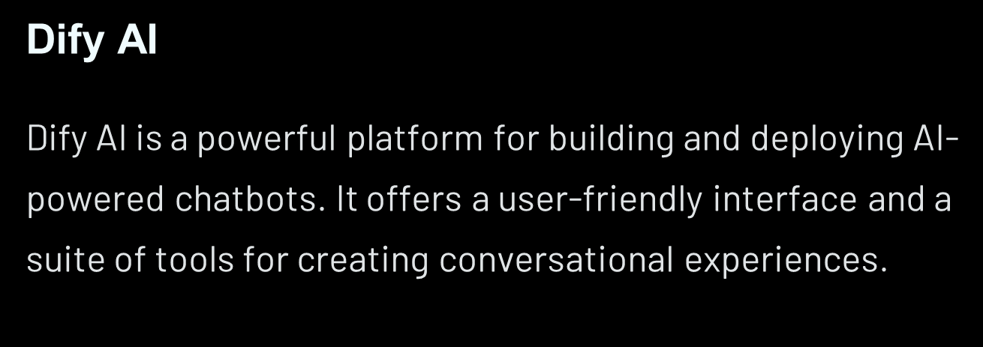
Introduction to Dify AI and the Kaggle Heart Dataset
Kaggle Heart Dataset
The Kaggle Heart CSV Dataset contains a wealth of information on cardiovascular health, including age, cholesterol levels, and blood pressure.

Slide 4

Innovation and Creativity:
Unique Idea: Using Dify AI to build an interactive diagnosis tool.
Inspiration: The rising need for accessible health diagnostics.
Creative Features: Symptom-based interactions, real-time feedback, and an intuitive interface.

Slide 5
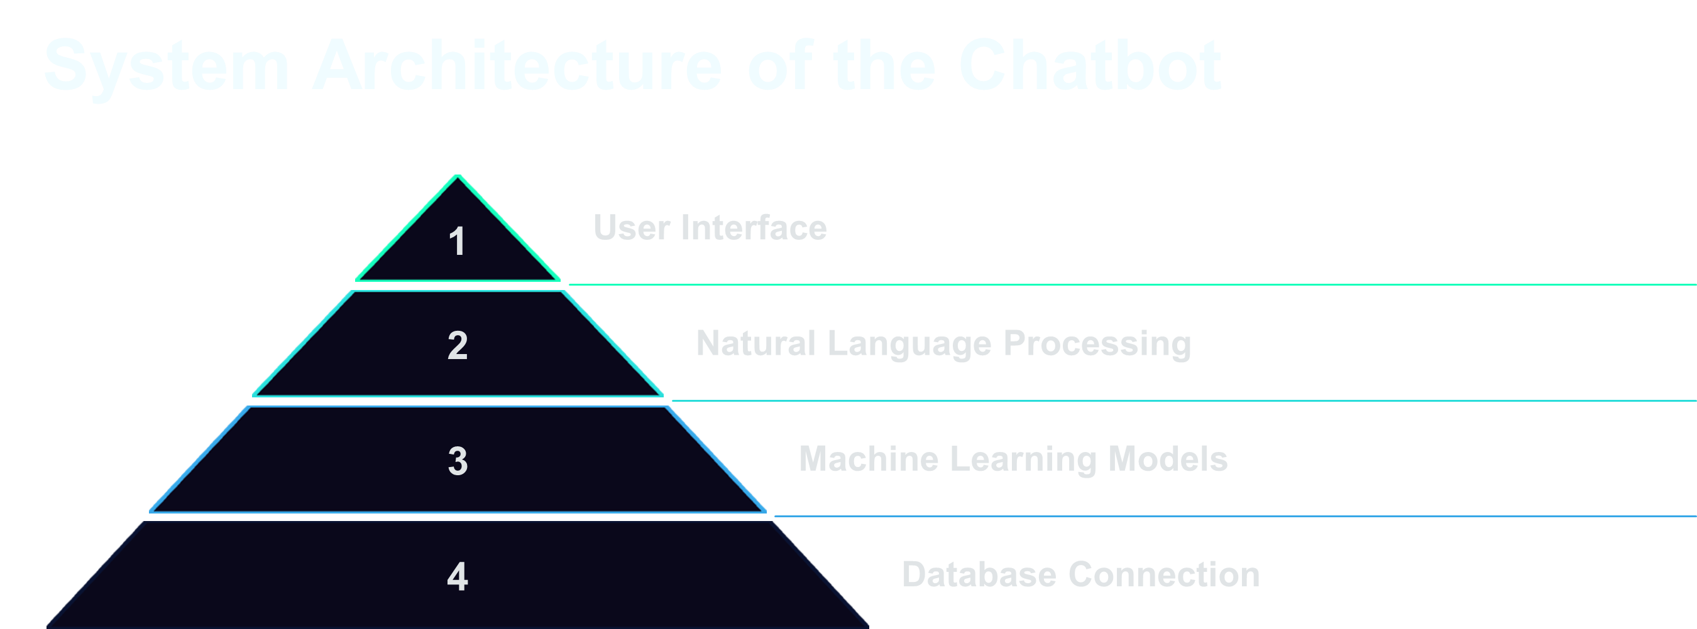

Slide 6

Detailed Technical Implementation
Data Preprocessing
Machine Learning Model Training
The Kaggle Heart Dataset was preprocessed to clean, transform, and prepare it for training the chatbot.
A machine learning model was trained on the preprocessed data using Dify AI's model training capabilities.
Natural Language Processing Integration
Dify AI's NLP capabilities were used to enable the chatbot to understand and respond to user queries.

Slide 7





Key Challenges
Accuracy and Reliability
Privacy and Security
Protecting user privacy and security of sensitive health data.
Ensuring the chatbot's predictions are accurate and reliable.
User Adoption and Engagement
Encouraging user adoption and engagement with the chatbot.
Notes:
7

Slide 8

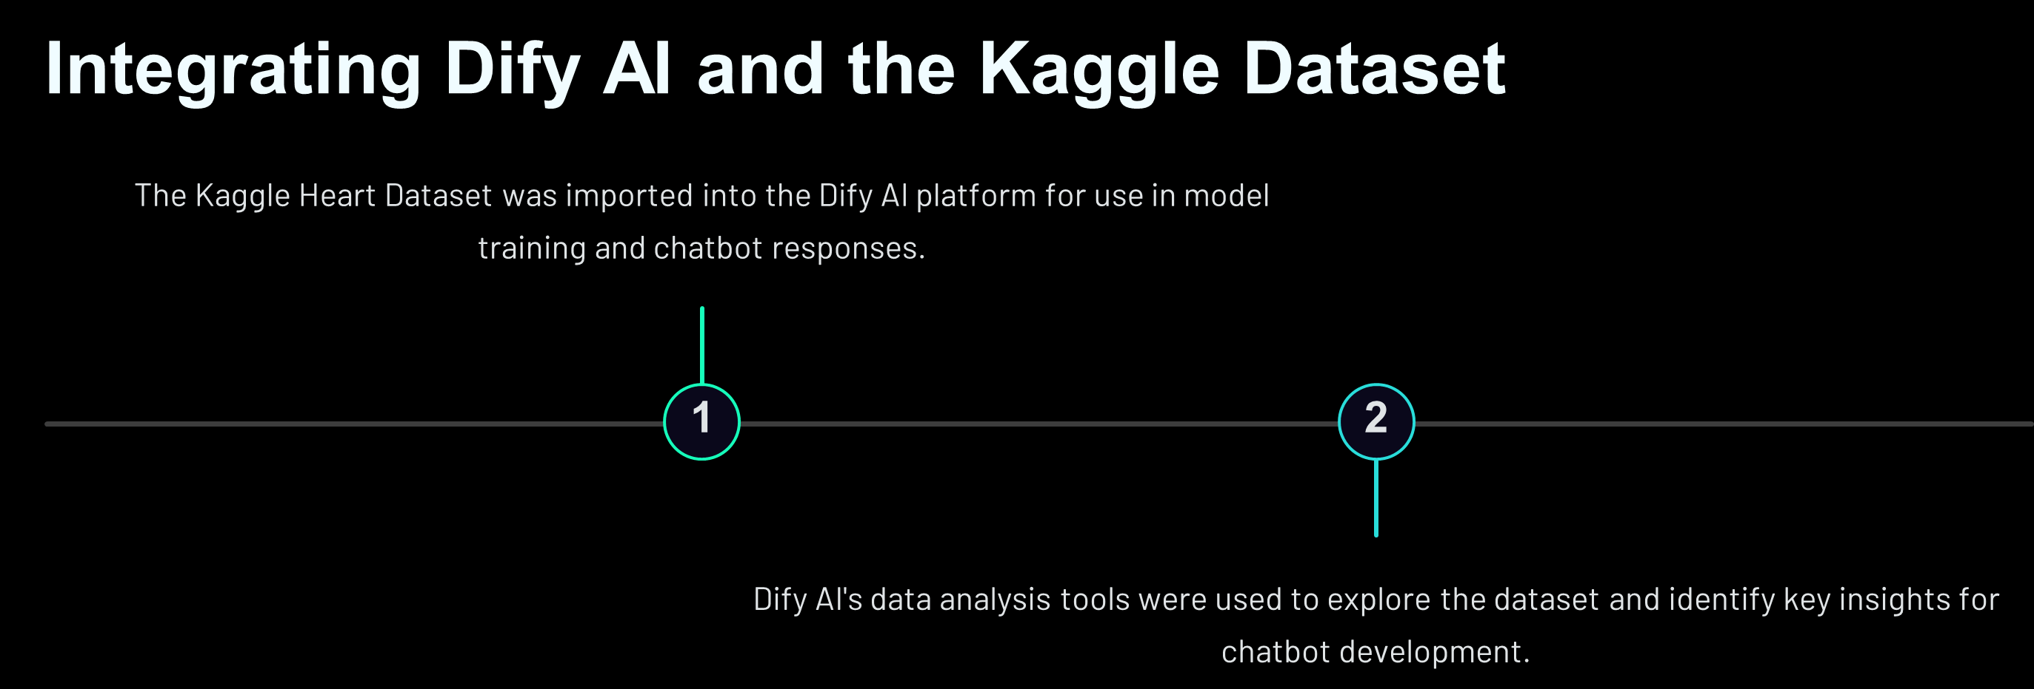

Slide 9

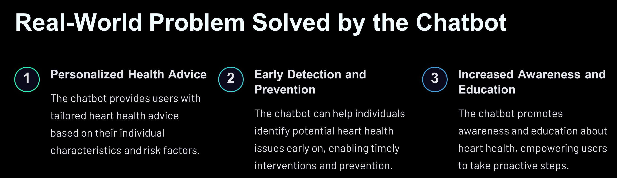

Slide 10
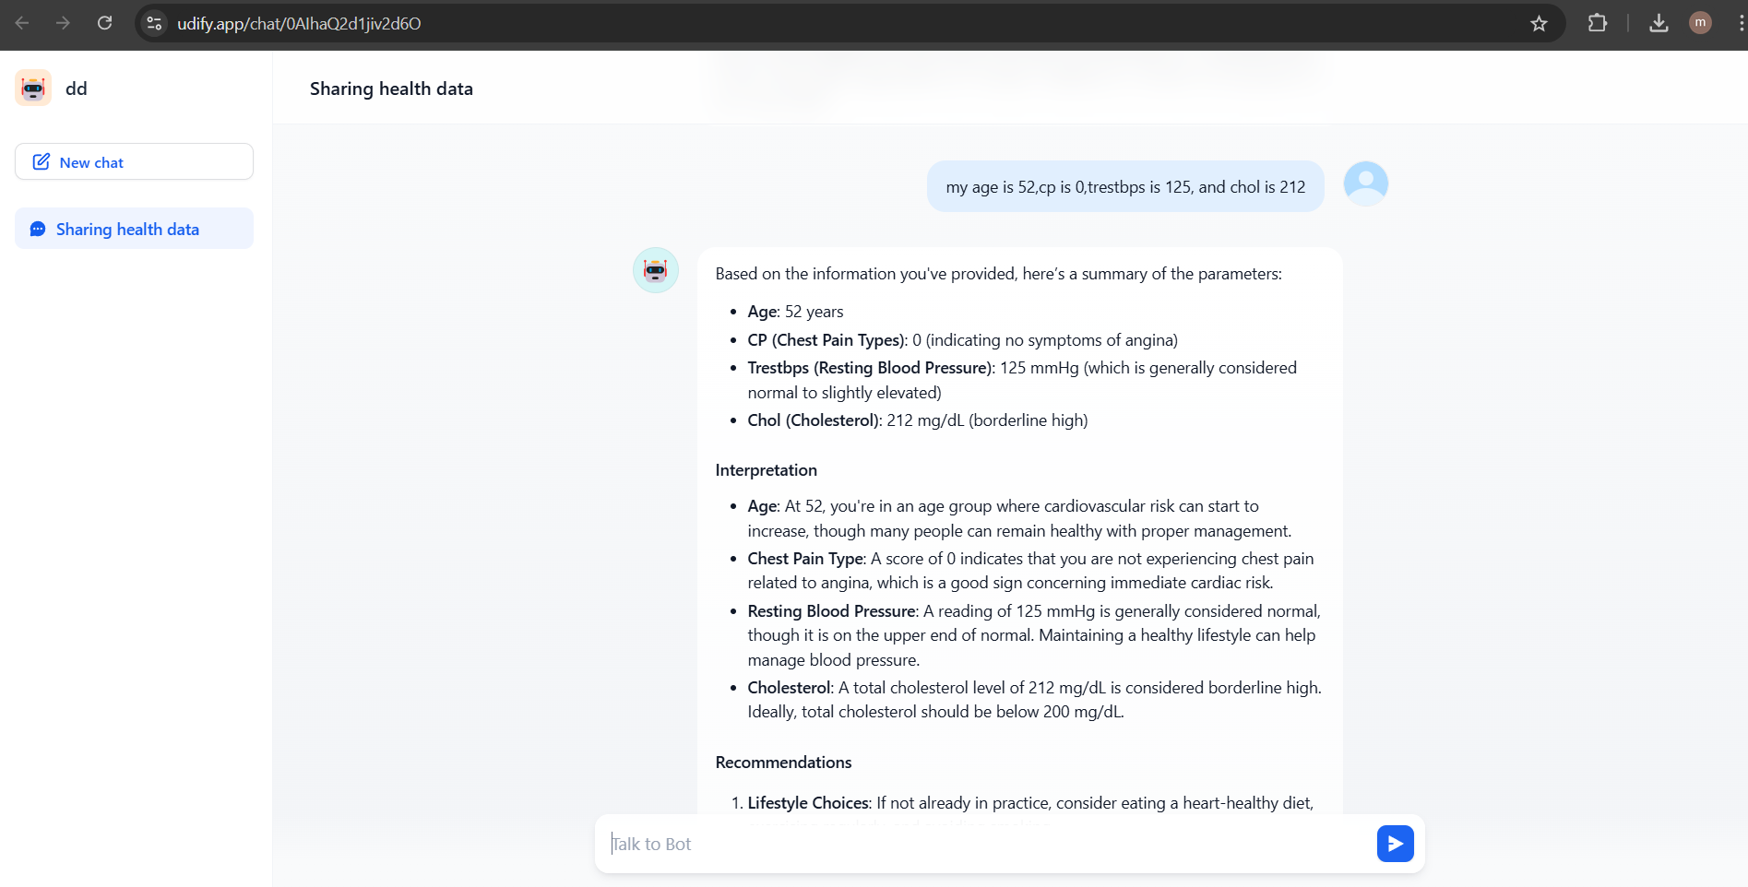
Project Demo
Functional Walkthrough: Screenshots of the chatbot interface and its responses.

Slide 11
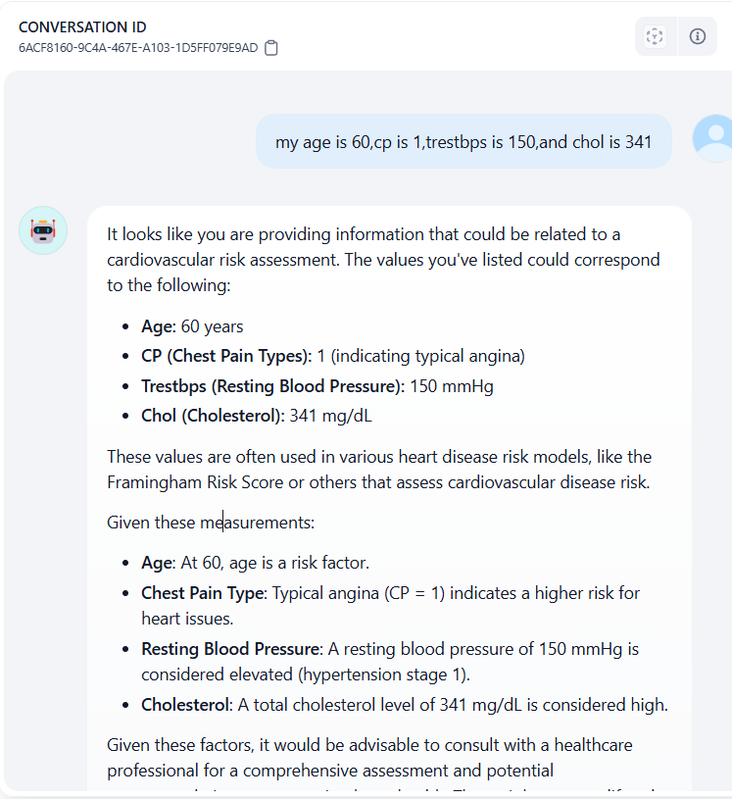
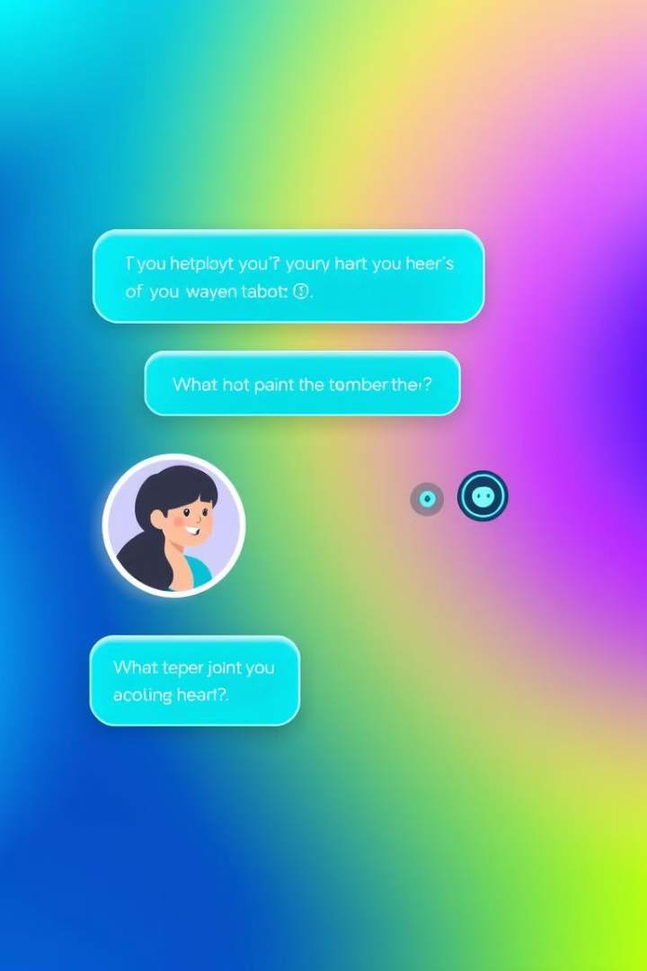




Conversational Flows and User Interactions
Greeting and Introduction
The chatbot initiates a friendly greeting and explains its purpose.
User Information Collection
The chatbot gathers relevant information from the user, such as age, gender, and medical history.
Personalized Recommendations
Based on the user's information, the chatbot provides personalized heart health advice and recommendations.
Ongoing Support and Engagement
The chatbot offers ongoing support and encouragement to users, promoting positive health behaviors.

Slide 12
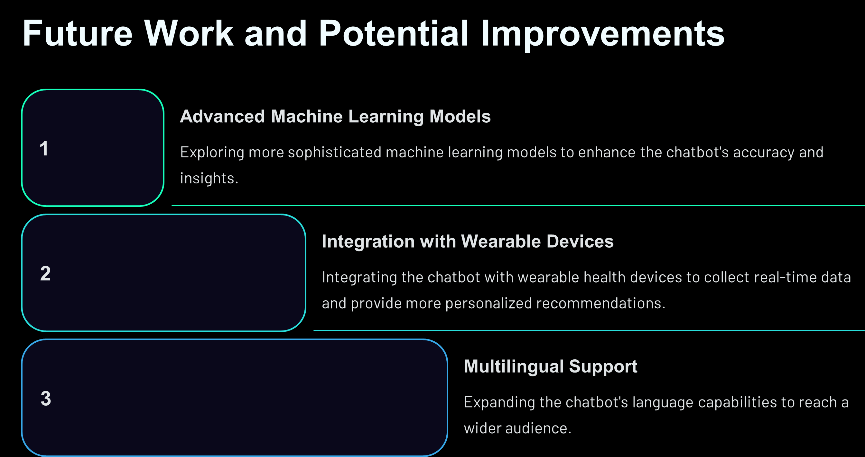

Slide 13

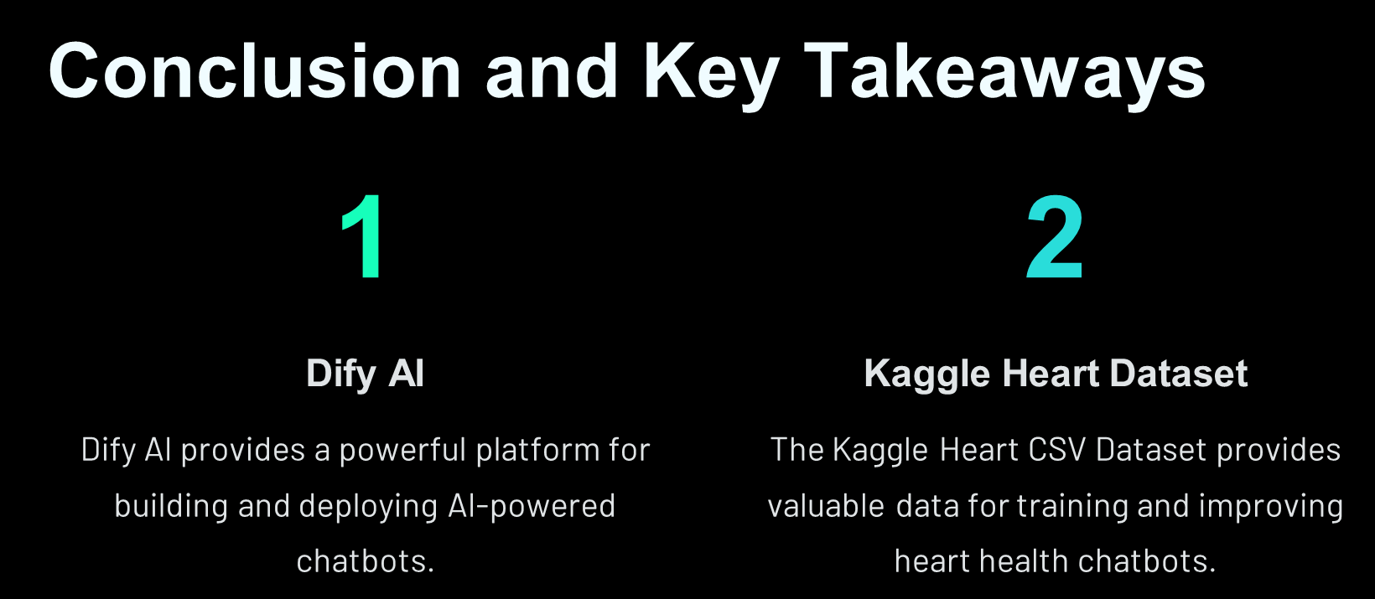

Slide 14



Potential Impact
Early Diagnosis
Providing timely diagnosis can lead to better health outcomes.
Reduced Healthcare Burden
Early diagnosis can potentially reduce the burden on the healthcare system.
Notes:
8

Slide 15


